Slide 1


Fashion-MNIST Classification Using Deep Learning
A comprehensive technical analysis comparing Artificial Neural Networks and Convolutional Neural Networks for automated fashion item classification across ten distinct categories.

Slide 2
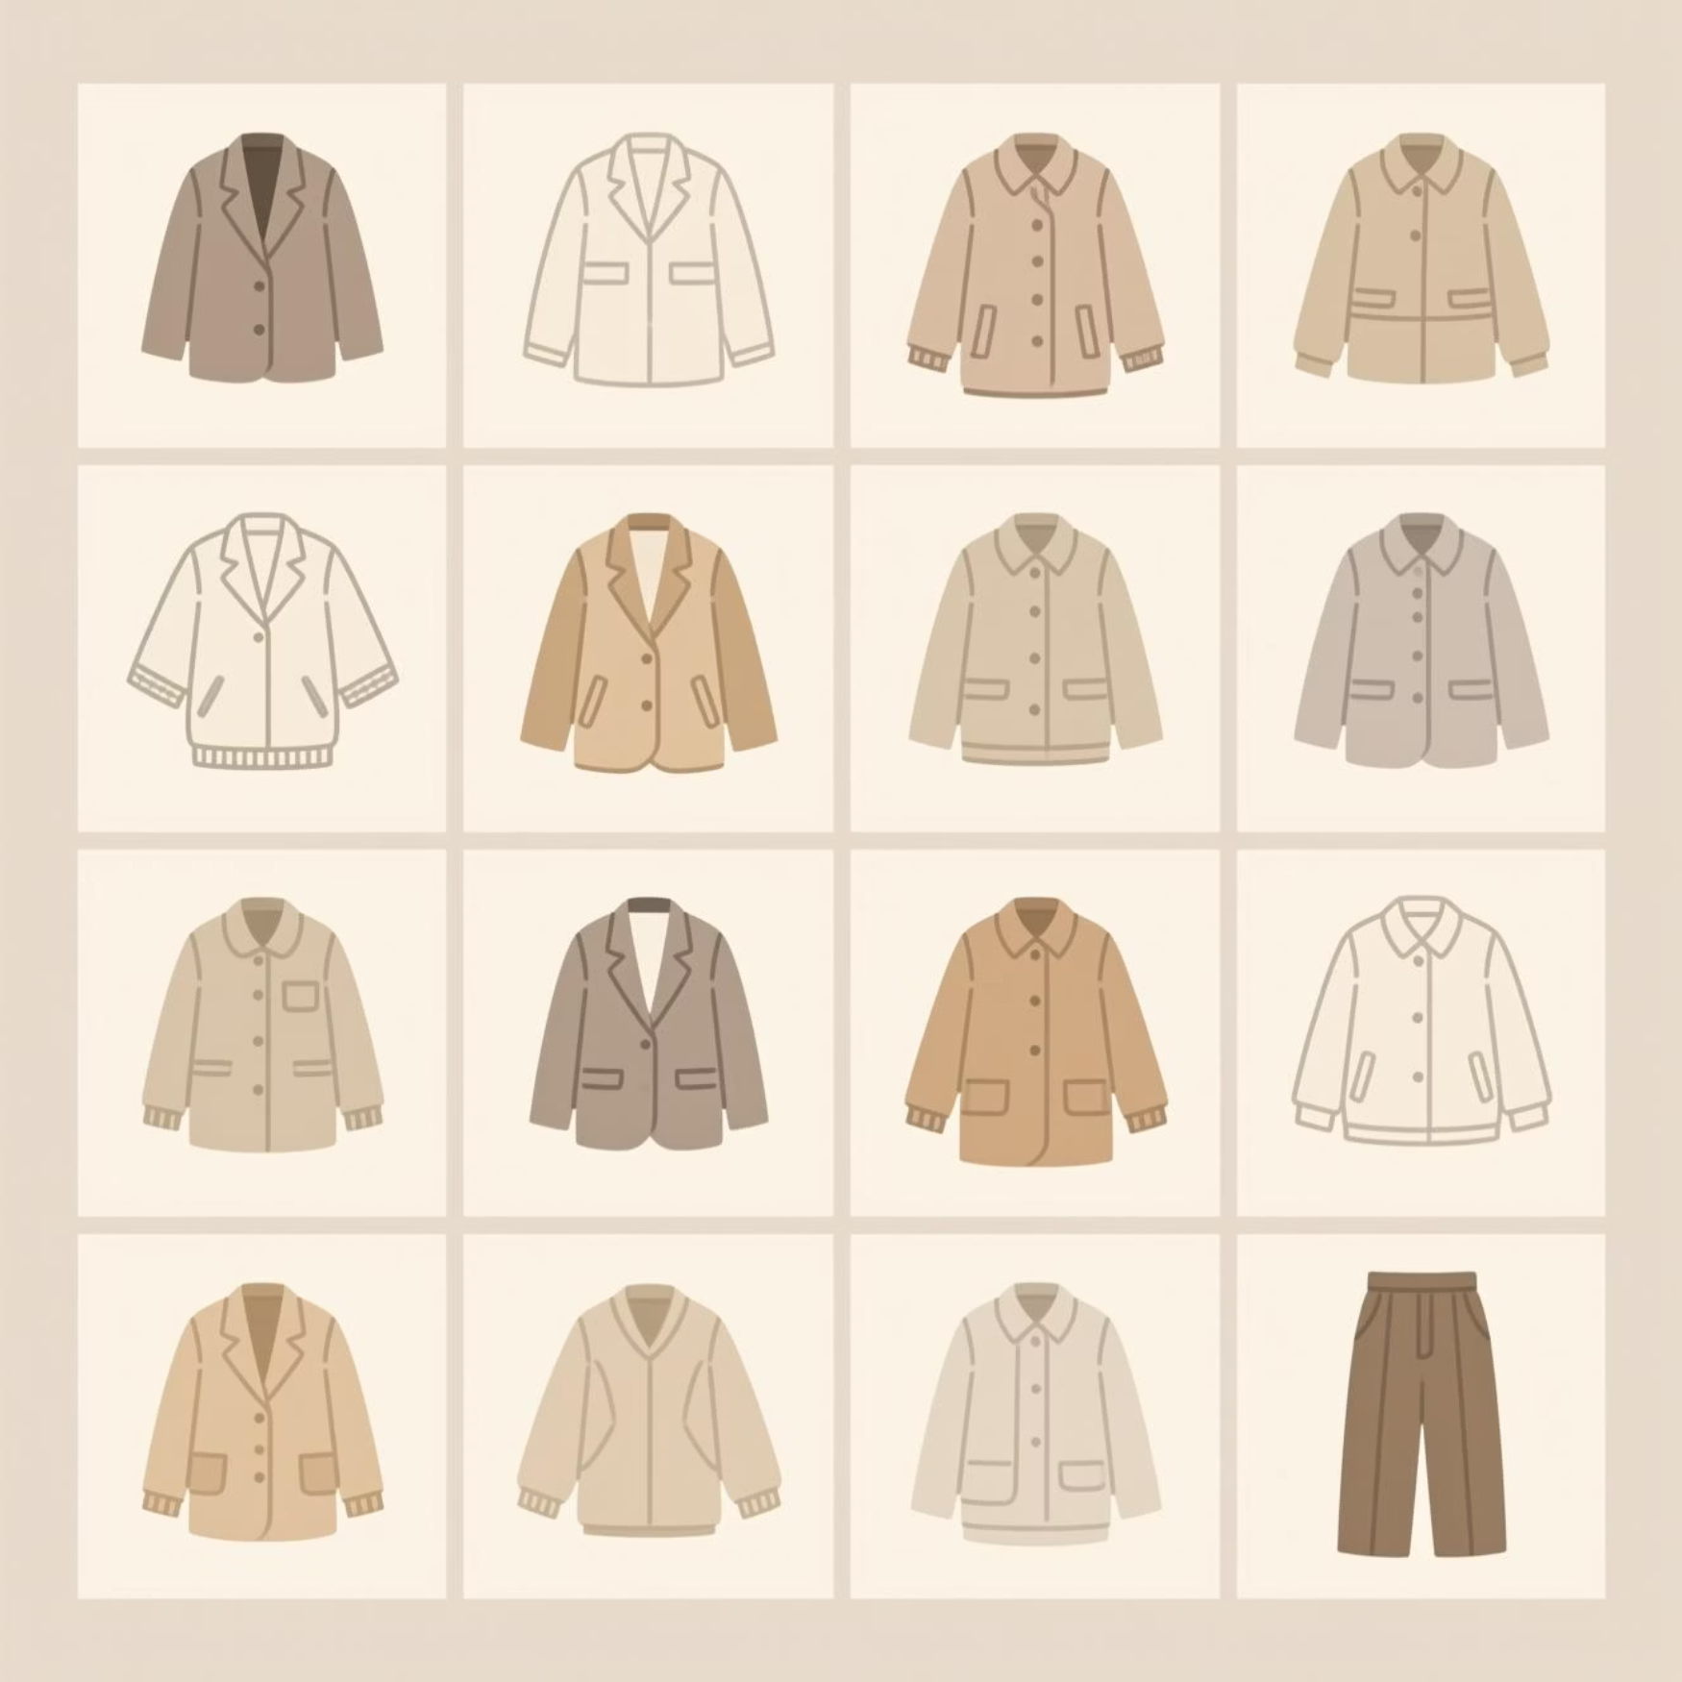
The Challenge: Multi-Class Fashion Recognition
Classification Task
Automatically categorizing 28×28pixel grayscale fashion images into ten distinct categories presents unique challenges beyond traditional digit recognition.
The Fashion-MNIST dataset contains 70,000 images spanning T-shirts, trousers, pullovers, dresses, coats, sandals, shirts, sneakers, bags, and ankle boots—each with subtle visual variations.
1
2
3
Visual Similarity
Style Variation
Resolution Limits
Distinguishing shirts from T-shirts and coats from pullovers requires nuanced pattern recognition.
Each category contains diverse designs, orientations, and stylistic interpretations.
Low-resolution grayscale images obscure fine-grained distinguishing features.

Slide 3
Dataset Architecture & Preparation
Dataset Composition
Preprocessing Pipeline
Training Images
60,000
01
02
Normalization
Stratified Split
Test Images
10,000
Pixel values scaled from [0, 255] to [0, 1] for optimized convergence and consistent feature scales.
Training data divided into 48,000 training and 12,000 validation images maintaining class distribution.
Dimensions
28×28×1
Classes
10 categories
Format
Grayscale
03
CNN Reshaping
Images reshaped to (28, 28, 1) format to satisfy convolutional layer dimensional requirements.

Slide 4


Two Architectural Approaches
Artificial Neural Network (ANN)
Convolutional Neural Network (CNN)
A traditional multilayer perceptron treating images as flat 784-dimensional feature vectors without spatial awareness.
Sophisticated architecture exploiting spatial hierarchies through progressive feature extraction from local patterns.
Flatten layer: 784 input features
Conv2D layers: 32 → 64 → 64 filters
Dense layers: 128 → 64 → 10 units
MaxPooling: Spatial dimensionality reduction
Dropout: 30% regularization
Dropout: 25-50% adaptive regularization
Total parameters: 109,386
Total parameters: 93,322 (14.7% fewer)
Baseline model for establishing performance benchmarks and comparison metrics.
Hierarchical feature learning from edges to complex garment-specific patterns.

Slide 5
CNN Achieves Superior Performance
89.8%
87.5%
93K
109K
CNN Test Accuracy
ANN Test Accuracy
CNN Parameters
ANN Parameters
Outperforming ANN by 2.33 percentage points with fewer parameters
Strong baseline performance treating images as unordered features
Parameter-efficient architecture through convolutional weight sharing
More parameters required for fully-connected layer architecture
—
The CNN's architectural advantages—spatial awareness, hierarchical feature extraction, and parameter sharing—translate directly into measurable performance gains while maintaining computational efficiency.

Slide 6
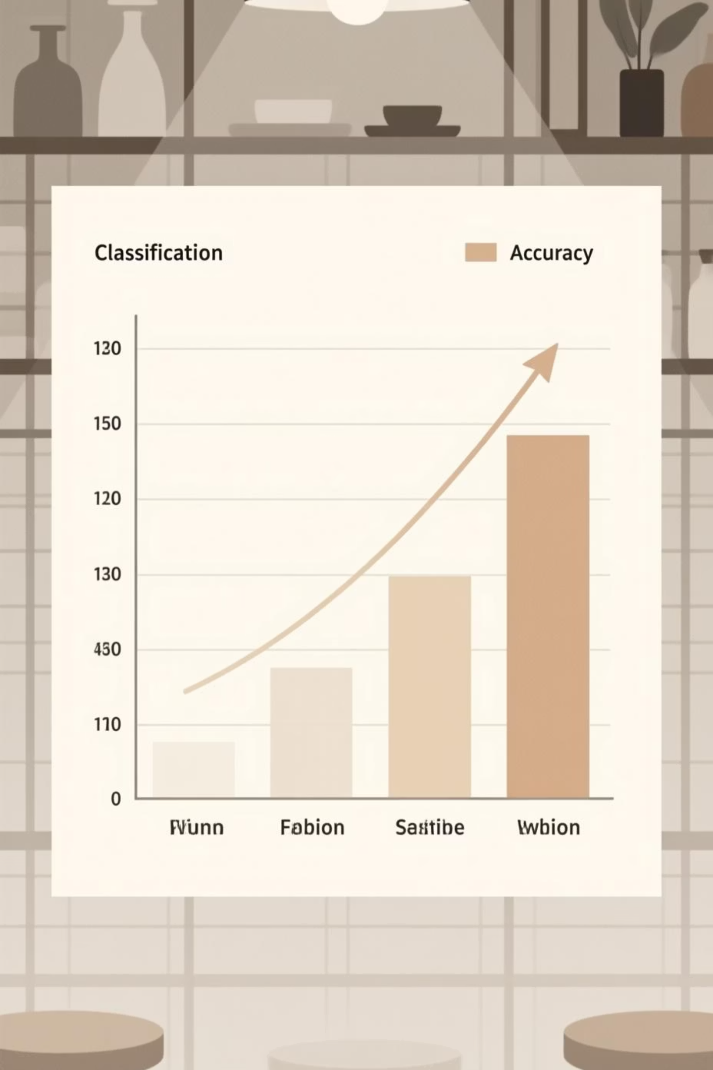
Class-Wise Performance Reveals Key Insights
Category-Specific Accuracy Analysis
Exceptional Performance
Challenging Categories
Bag: 98.0% accuracy
Shirt: 62.5% accuracy (+10.3% improvement)
Sneaker: 97.5% accuracy
Pullover: 87.6% accuracy (+5.6% improvement)
Trouser: 96.9% accuracy
Distinctive shapes and silhouettes enable near-perfect classification.
T-shirt/top: 89.9% accuracy
Visual similarity between upper-body garments creates classification ambiguity.
CNN Advantages
Convolutional architecture demonstrates particularly strong improvements on visually similar categories.
Spatial feature detection enables better discrimination of subtle differences like collars, sleeves, and necklines.

Slide 7

Understanding Classification Errors
Top Confusion Patterns
Actual
Predicted
Count
Shirt
T-shirt/top
149
Shirt
Coat
99
Shirt
Pullover
91
Coat
Pullover
76
T-shirt/top
Shirt
63
Shape Similarity
Texture Ambiguity
Detail Omission
Pullovers and coats share overlapping silhouettes, particularly when sleeves and collars have similar configurations.
Low-resolution grayscale images obscure fabric textures that distinguish shirts from T-shirts.
Small distinguishing features like buttons, zippers, or specific neckline styles fall below the 28×28 pixel resolution threshold.

Slide 8




Why CNNs Excel at Image Classification
Spatial Awareness
Local connectivity and weight sharing preserve spatial relationships between pixels, detecting localized patterns like garment features.
Hierarchical Learning
Progressive feature extraction from edges and textures in early layers to complex shapes and garment-specific patterns in deeper layers.
Parameter Efficiency
Convolutional weight sharing reduces parameters by 14.7% while improving accuracy, minimizing overfitting risk and enhancing generalization.
The CNN's architectural innovations mirror biological vision systems, processing images through hierarchical feature detection rather than treating them as unordered data vectors.

Slide 9




Future Research Directions
Architectural Innovation
Data Enhancement
Technical Optimization
Practical Applications
Implement comprehensive augmentation including rotation, scaling, and contrast adjustment. Generate synthetic examples using GANs and transfer learning.
Deploy learning rate scheduling, batch normalization for training stability, and ensemble methods combining multiple architectures.
Extend to multi-label outfit classification, temporal trend analysis, and real-time mobile classification systems for retail environments.
Explore ResNet, DenseNet, and EfficientNet architectures with attention mechanisms and capsule networks for enhanced spatial relationship handling.

Slide 10

Key Takeaways
CNN Superiority Demonstrated
Convolutional architecture achieved 89.80% accuracy, outperforming traditional ANNs by 2.33% with 14.7% fewer parameters.
Spatial Intelligence Matters
Hierarchical feature extraction and spatial awareness prove essential for distinguishing visually similar fashion categories.
Practical Foundation Established
Strong baseline performance enables real-world applications from inventory management to trend analysis, with clear pathways for enhancement.
Visual Similarity Remains Challenging
Upper-body garment discrimination represents the primary classification barrier, requiring advanced architectures and augmentation strategies.

